Slide 1


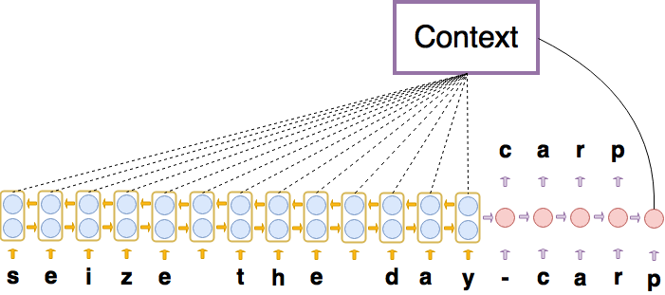
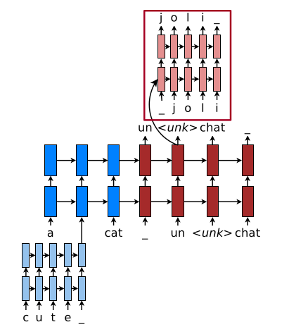
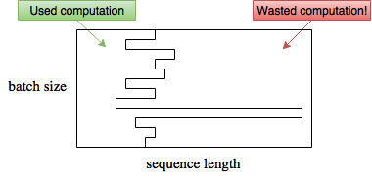
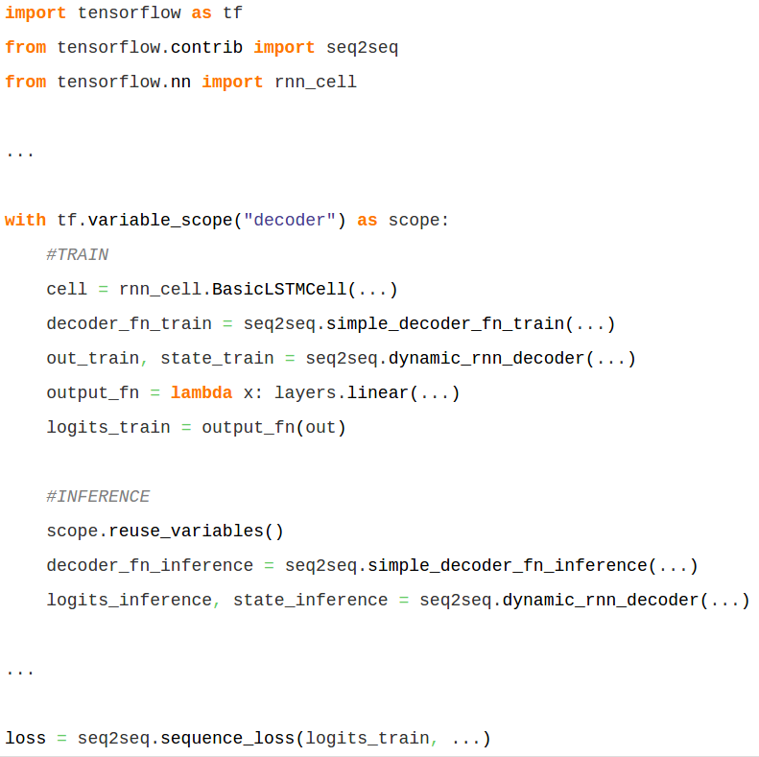
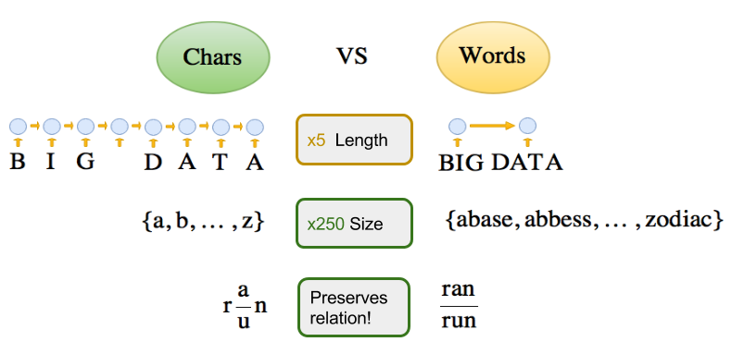
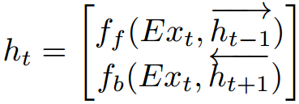
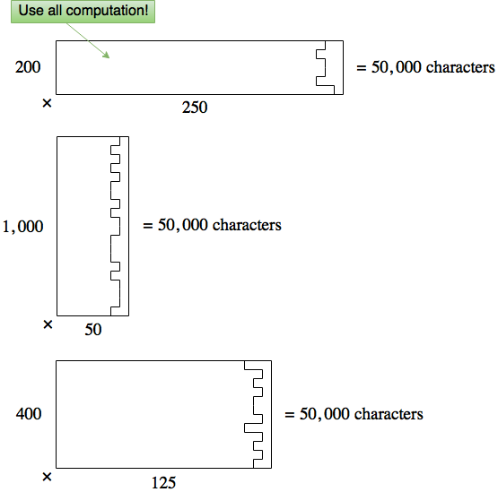
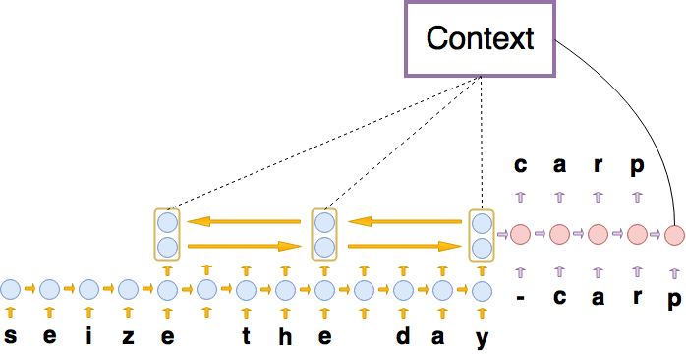
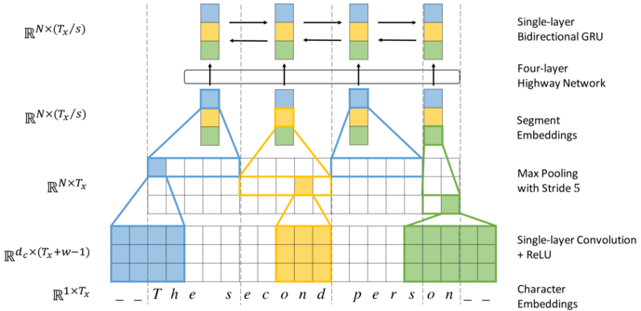

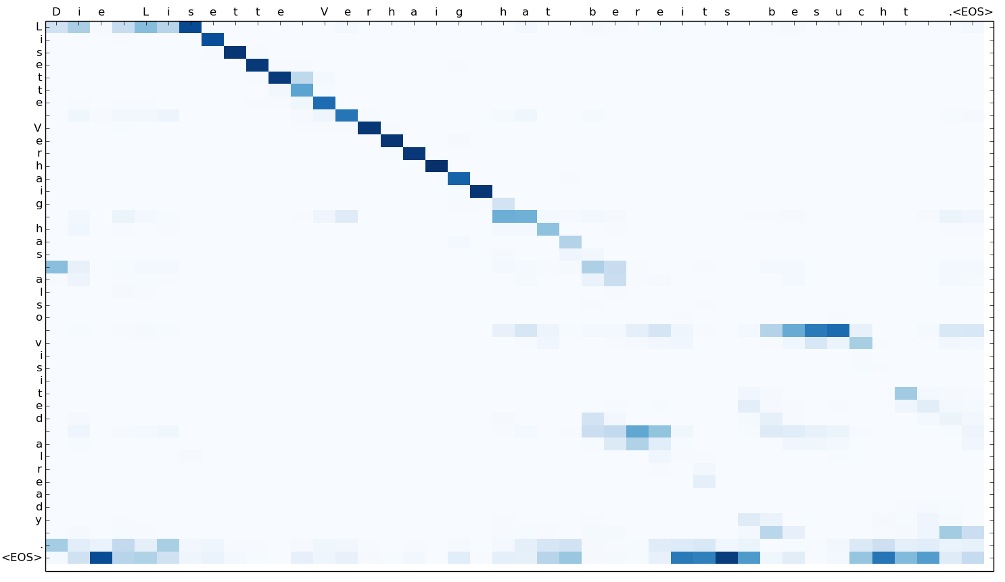
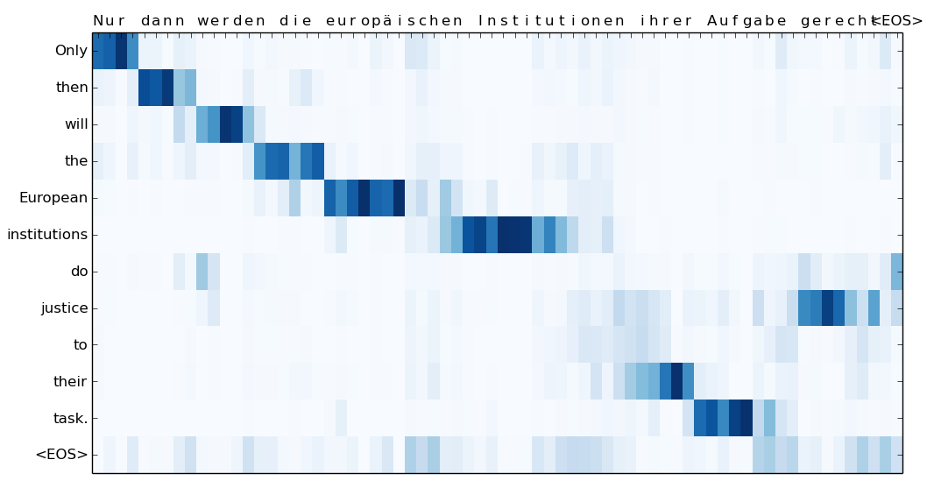
Insect Classification Using Deep Learning
Freja Thoresen (S213769), Nikolaj Sheller (C971666), Pascal Remy Dufour (S011602) FaunaPhotonics A/S
Introduction
Model
Computation
Related Models
Neural machine translation (NMT) uses deep learning to achieve State-Of-The-Art for translation. However, most published NMT uses word-level encodings^{1,2}
char-to-char
Normal batching
Merged to TensorFlow!
Hybrid Word-Character⁶
³
Dynamic batching⁵
Is a RNN memory Cell⁴
char2word-to-char
Character Segmentation⁷
Key contributions:
Char2Word encoder mechanism
Char-to-char seq2seq interpretation
Dynamic Batching
Results - Qualitative
Replaces
Results - Quantitative
char-to-char attention plot
char2word-to-char attention plot
Model | Language | newstest2015
char-to-char | En-De | 15.14 BLEU
char2word-to-char | En-De | 17.43 BLEU
Char-level
References
Word-level
[1] Dzmitry Bahdanau, Kyunghyun Cho, and Yoshua Bengio. Neural machine translation by jointly learning to align and translate. CoRR, 2014.
[2] Ilya Sutskever, Oriol Vinyals, and Quoc V. Le. Sequence to sequence learning with neural networks. CoRR, 2014.
[3] M. Schuster and K.K. Paliwal. Bidirectional recurrent neural networks. Trans. Sig. Proc., 45(11):2673–2681, November 1997.
[4] Sepp Hochreiter and Jürgen Schmidhuber. Long short-term memory. Neural Comput., 9(8):1735–1780, November 1997.
[5] A. Y. Hannun, C. Case, J. Casper, B. Catanzaro, G. Diamos, E. Elsen, R. Prenger, S. Satheesh, S. Sengupta, A. Coates, and A. Y. Ng. Deep speech: Scaling up end-to-end speech recognition. CoRR, 2014.
[6] Minh-Thang Luong and Christopher D. Manning. Achieving open vocabulary neural machine translation with hybrid word-character models. CoRR, 2016.
[7] Jason Lee, Kyunghyun cho, Thomas Hofman. Fully Character-Level Neural Machine Translation without Explicit Segmentation. CoRR, 2016.
Notes:
<number>

